Slide 1

Big Data Project BUAN 6346 Group 1
By:
Likith Vinayaka Giridhar
Srinija Gamini
Ayush Gaur
Sadgun Chikoti
Manoj Eswar Naveen Chintu
Venkata Lakshmi Narayana Dasari
Driver Compliance and Safety Management through Data-Driven Approaches in ANT Fleet Risk Analytics

Slide 2
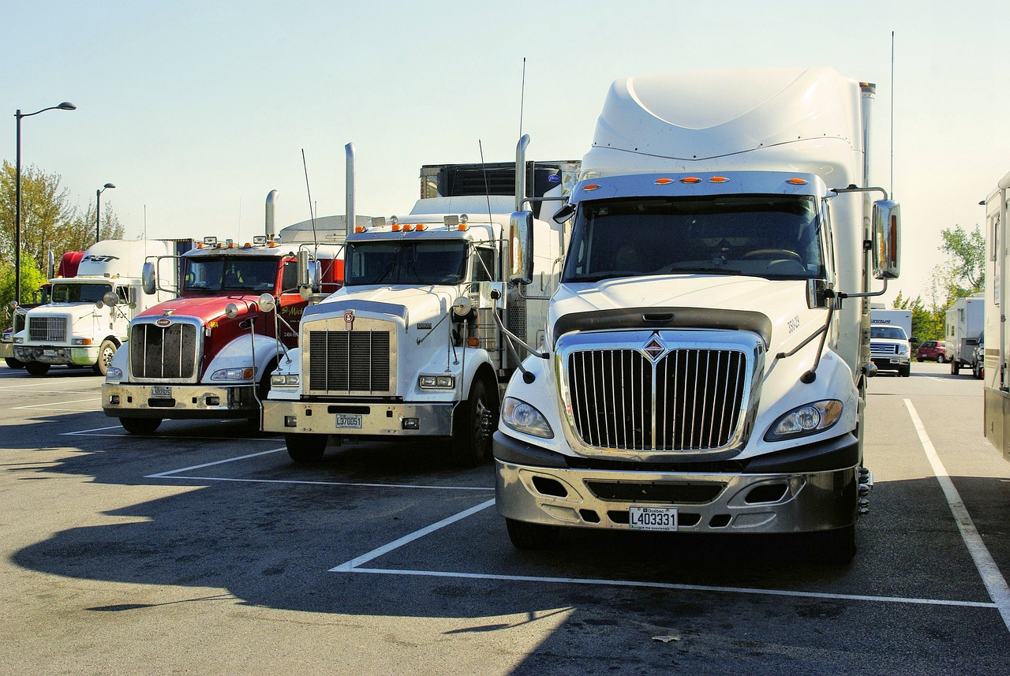
Problem Statement and Objective
Enforcing safety and regulatory compliance among drivers at Az National Trucking (ANT) poses a significant challenge. Elevated risk factors such as mileage, speed, and adherence to laws frequently surpass acceptable levels, increasing the likelihood of insurance complications.
Our primary objective is to develop a system capable of readily identifying drivers with a 'Mileage/Speed' risk score of 7.0 or higher. Our ultimate aim is to enhance safety, reduce insurance risks, and optimize the efficiency of our fleet.

Slide 3






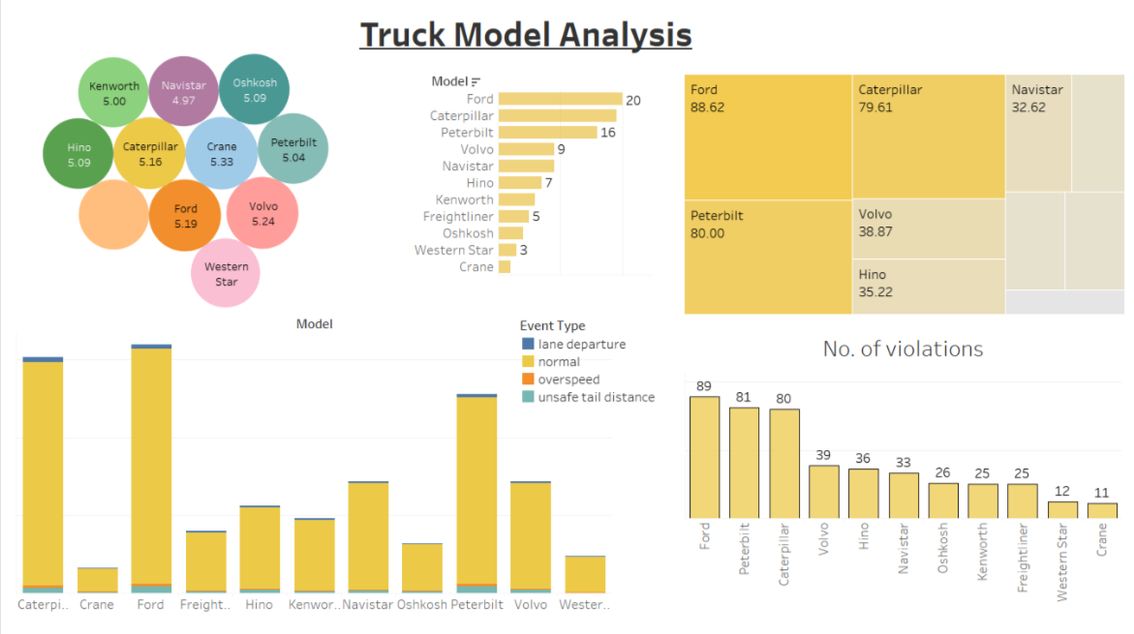


Process Workflow
Create tables
(geolocation,
trucks, and
trucks_mg)
move data to home/training
Load data Into HDFS
Connect to Tableau server
For visualizations
Connection using ODBC drivers for Impala
in hive and load data using LOAD DATA INPATH
Integrate Tableau with RStudio using Rserve
Download and move data
to Cloudera image
Created visualizations in Tableau

Slide 4
DATA PREPARATION
riskfactor
geolocation
driver_milage
trucks
trucks_milage
avg_milage
trucks_mg

Slide 5
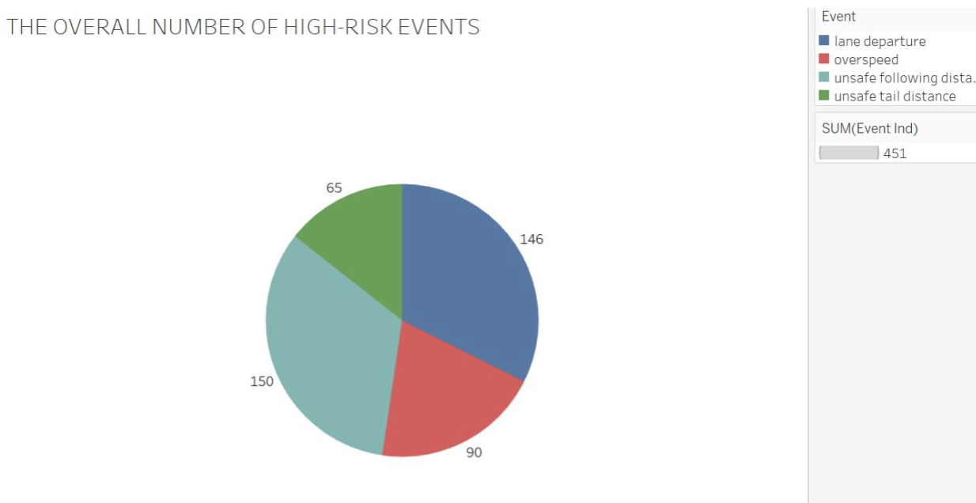
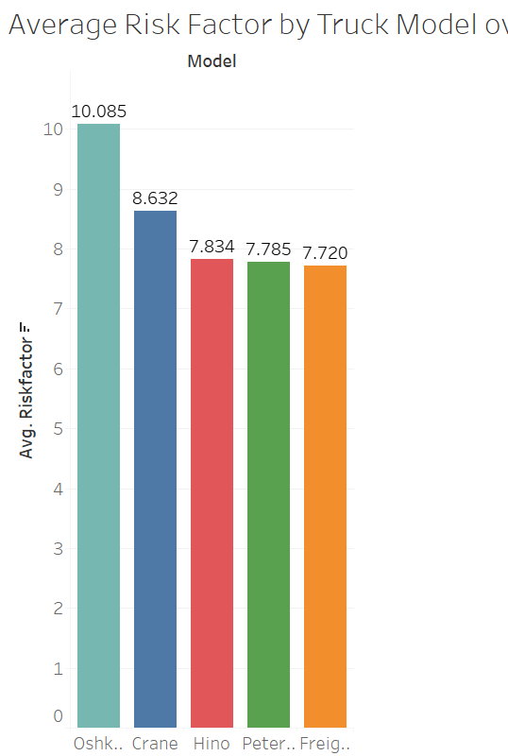
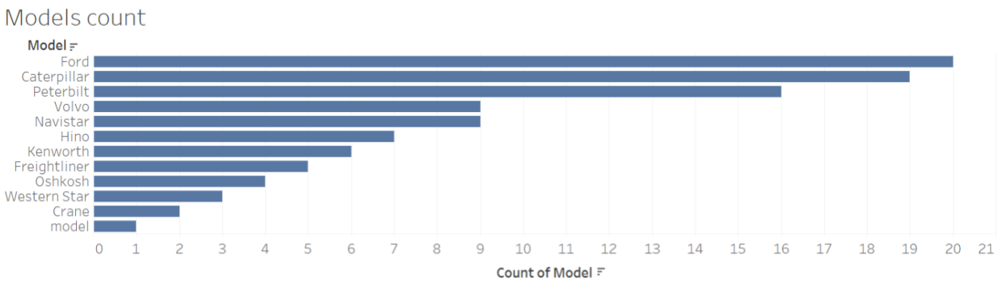
RISK FACTOR ANALYSIS BY TRUCK MODEL
Ford, Caterpillar, and Peterbilt are the top three truck models used.
Most common type of violations are lane departure, and unsafe tail distance.
If we look in totality, Oshkosh reported the highest risk factor.
Driver’s can be educated about the safe tail distance, and lane departure rules.

Slide 6
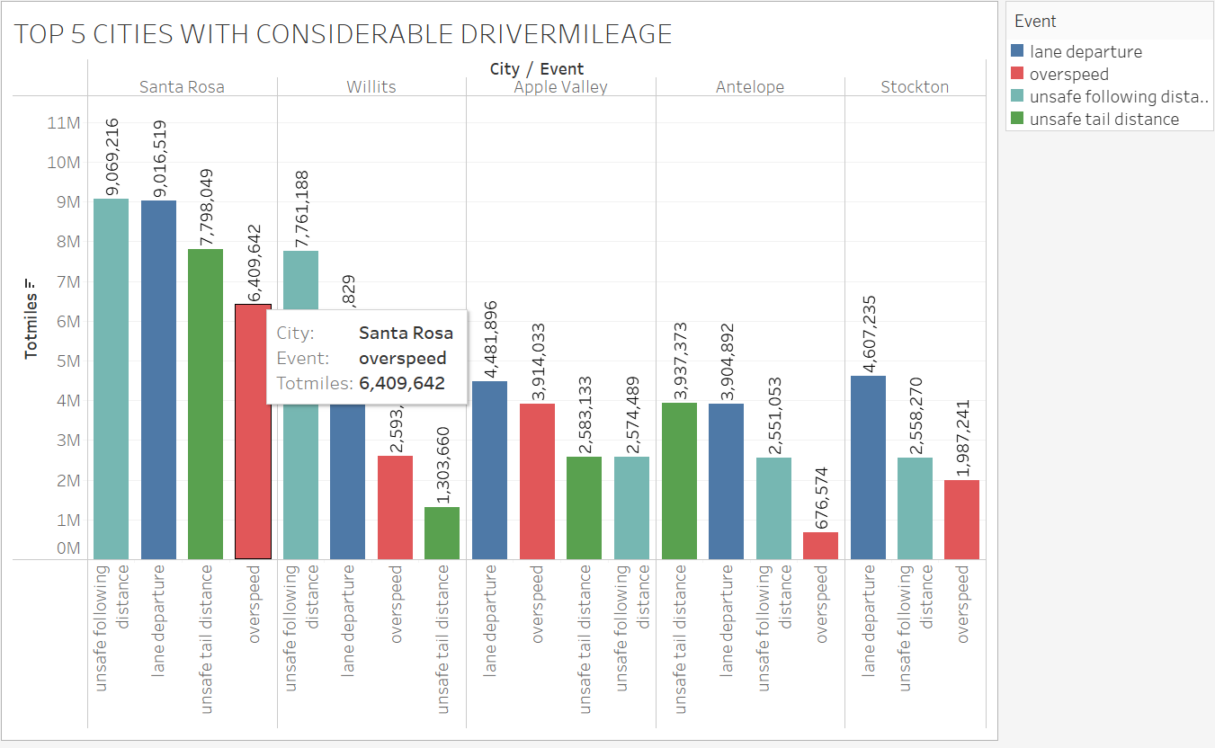
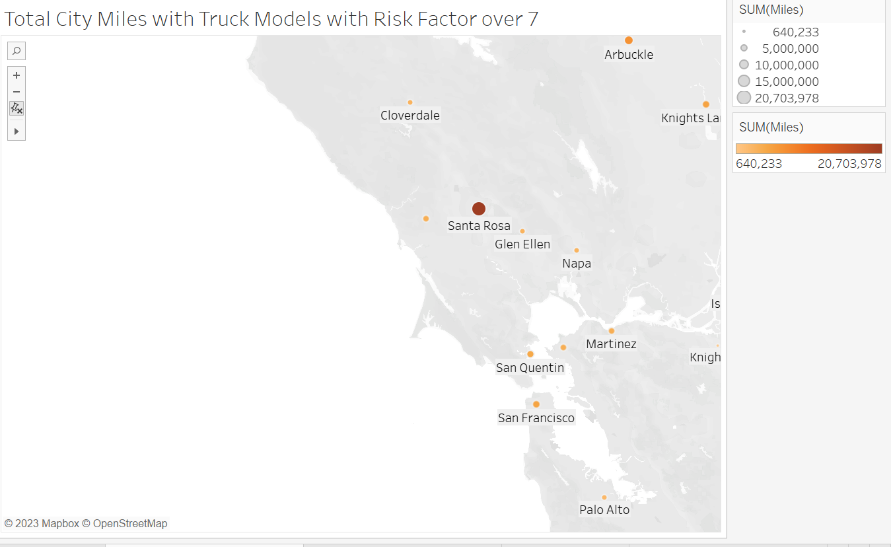
High Risk Analysis By City
Distribution of Event in Santa Rosa City
Lane departures: 9M
Over speeding: 6.4M
Unsafe following distances: 7.7M
Unsafe tailgating: 9M
Santa Rosa has the highest risk factor among the cities compared
The cities with the next highest risk factors are Willits, Antelope, Apple Valley, and Stockton

Slide 7
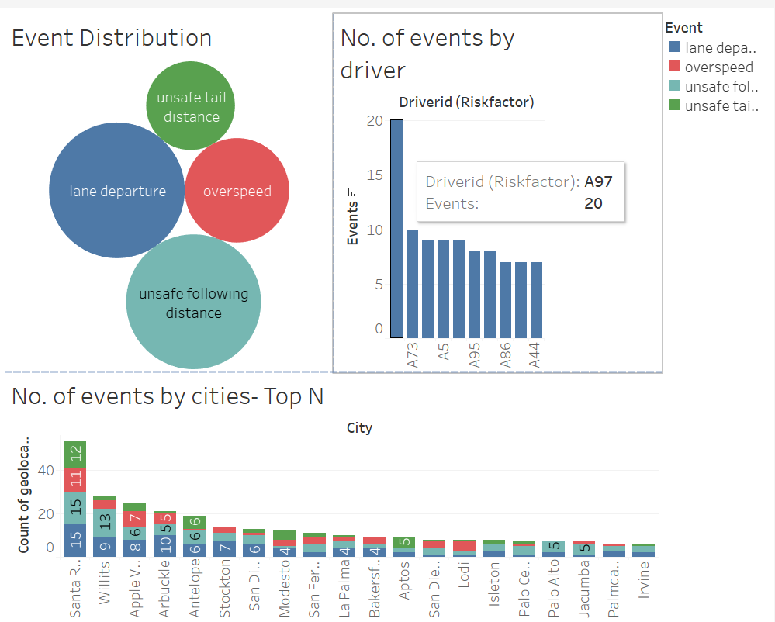
Event Distribution
Most Number of Events: Lane departure
Least Number of Events: Unsafe Tail Distance
A97 seems to be the riskiest driver followed by A73.
Santa Rosa has the highest number of events with lane departure and unsafe following distance being the most.
Unsafe following distance seems to be the highest in most of the Top 10 cities.

Slide 8
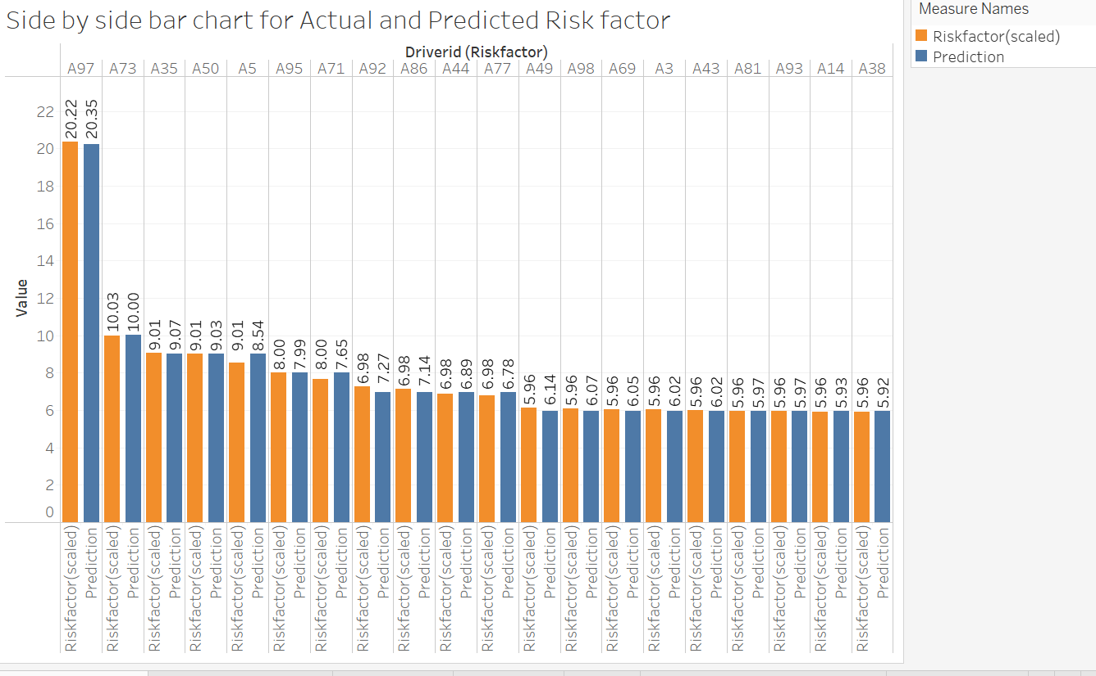
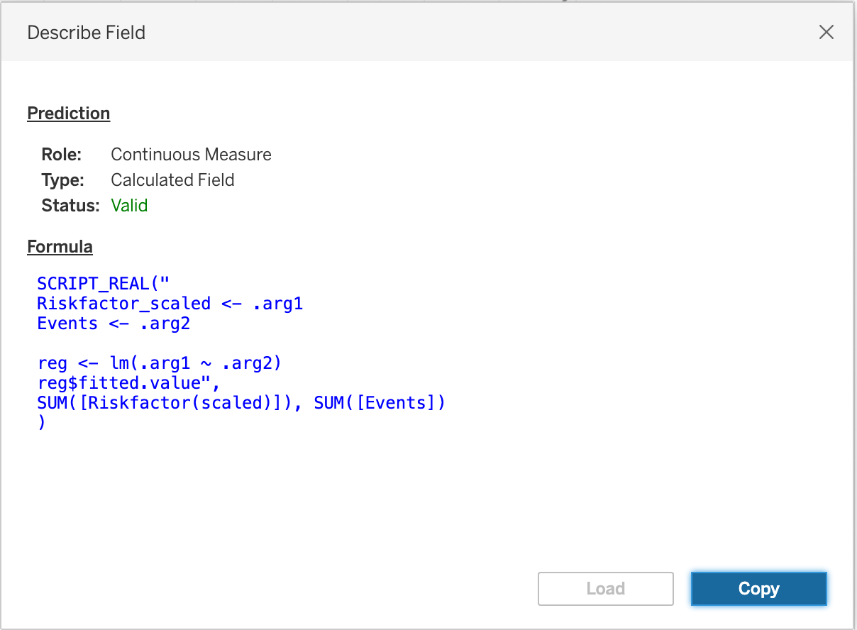
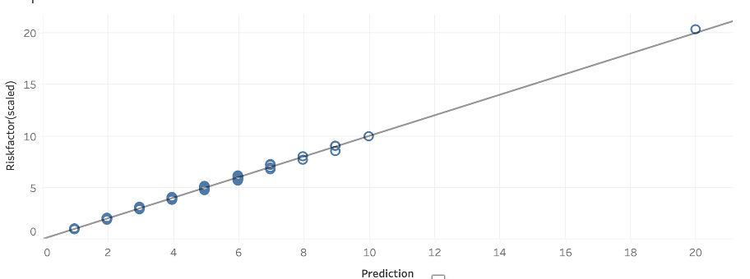
Comparing Actual and Predicted Risk Factor
The Prediction has a high R squared value indicating a very good fit.
Therefore, we can use this model to predict Riskfactor of drivers in unseen dataset

Slide 9
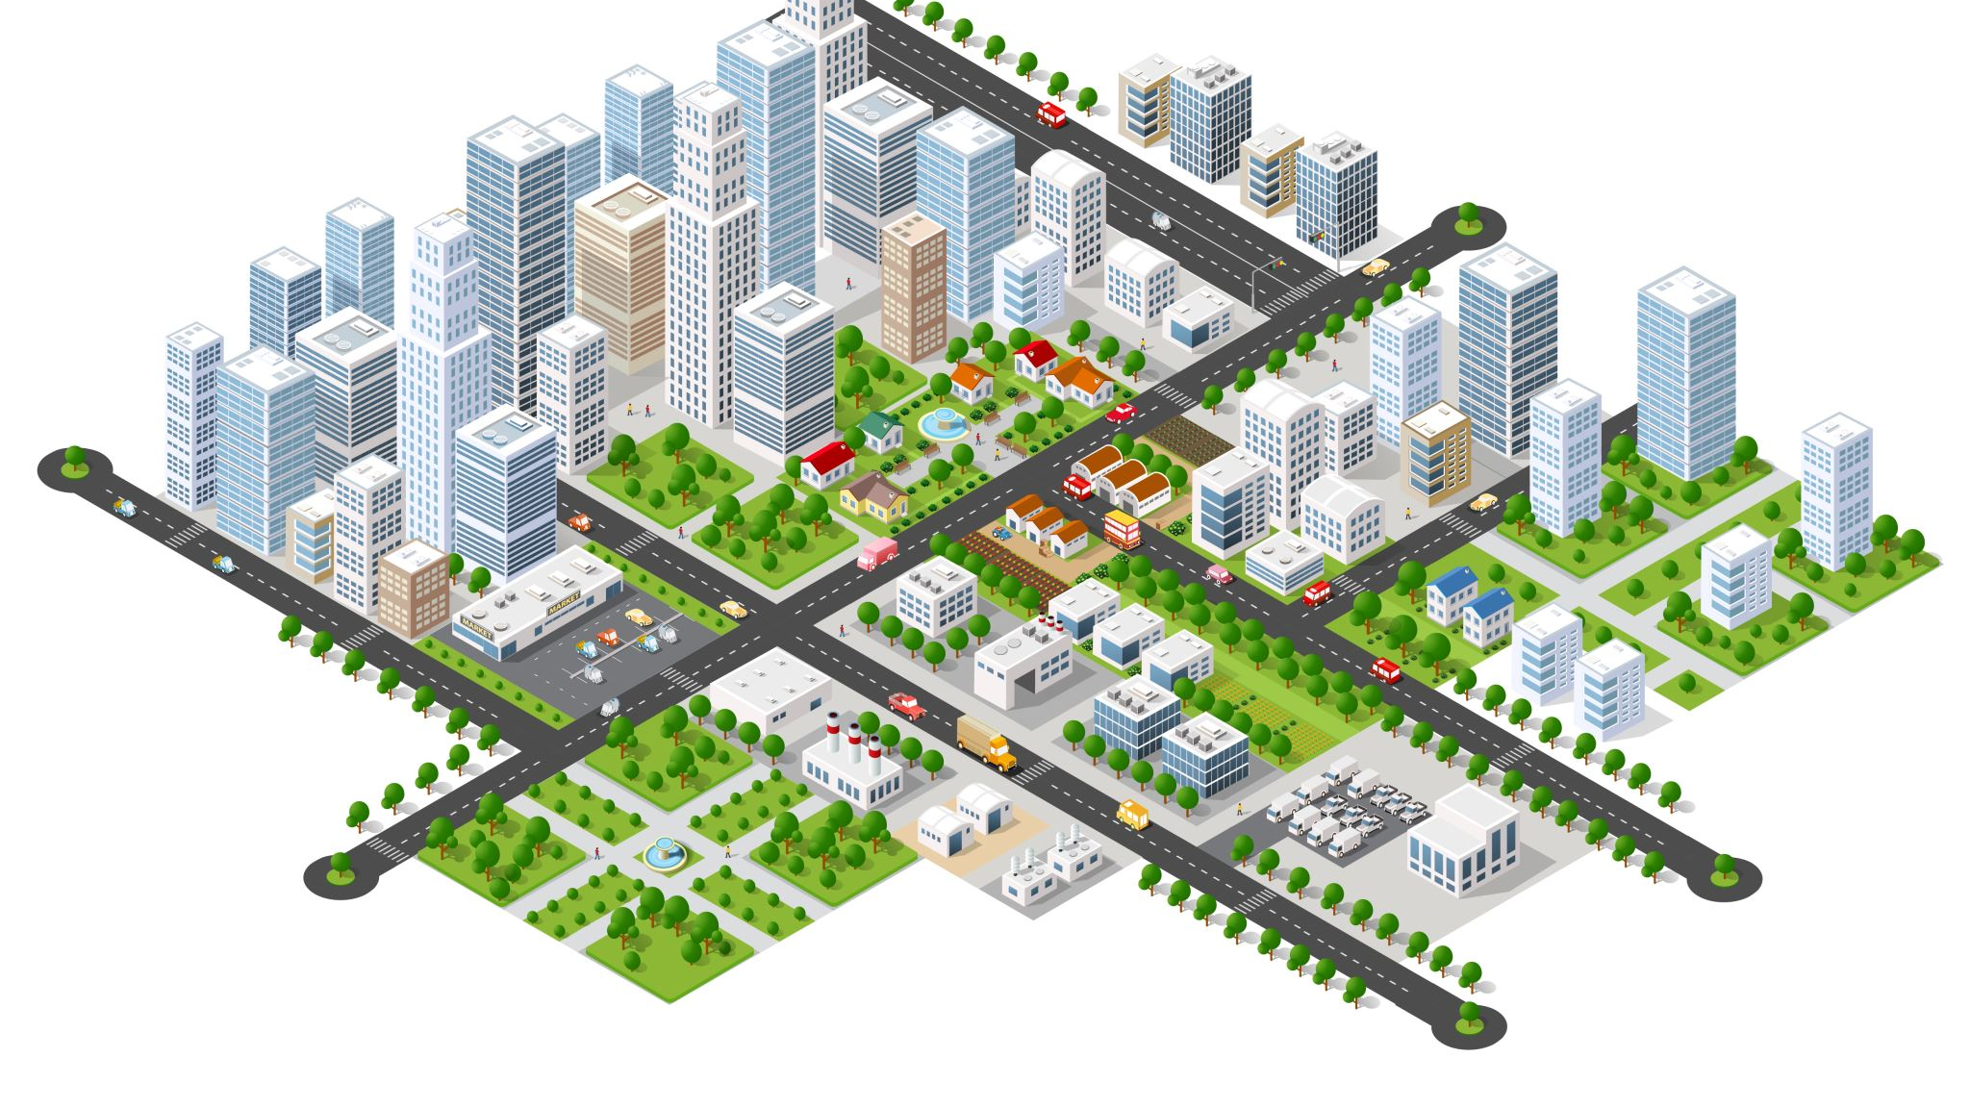
Conclusion and Future Scope
Key findings:
A97 is the driver with the highest risk factor.
The city of Santa Rosa has the highest number of events, with A92 being the riskiest driver in that location. Lane Departures and Unsafe following distances are the most common occurring events in the city..
"Unsafe Tail Distance" is the least frequently occurring event, while Unsafe Following Distance is the most common event among the top 10 cities.
Ford, Caterpillar, and Peterbilt are the most commonly used trucks overall, and our analysis indicates that they are the riskiest in terms of reported violations. However, when considering all events collectively, Oshkosh has the highest percentage of violation events.
ANT needs to throw light on implementing safety measures to reduce risks related to A97 and addressing common issues like Lane Departures and Unsafe Following Distances in high-risk cities like Santa Rosa, while also improving safety standards for popular truck models like Ford, Caterpillar, Peterbilt, and Oshkosh in the industry

Slide 10


